Slide 1
Sentimental Analysis
Obtained Insights from the reviews collected about British Airways from the passengers.

Slide 2
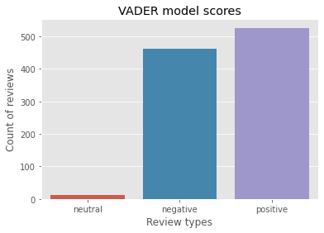
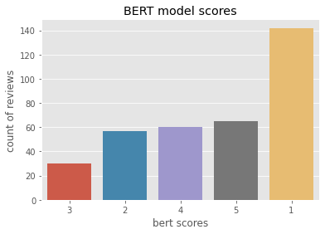
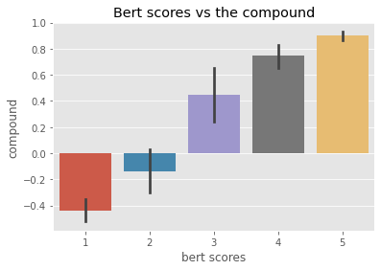
Outputs of VADER and BERT model
From the following graphs we can tell that in Vader model the positive and negative reviews are very close with few neutral reviews.
The BERT model has more poor rated reviews followed by other reviews of approximately same counts .
The compound value of Vader model with respect to BERT scores tell us that they are nearly normal

